Slide 1
Research Methods Support
Dissertation (COM726)

Slide 2
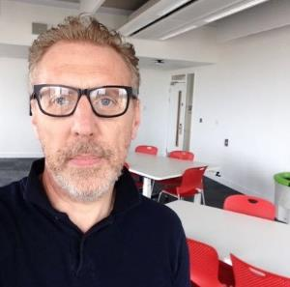
Martin Reid
martin.reid@solent.ac.uk

Slide 3
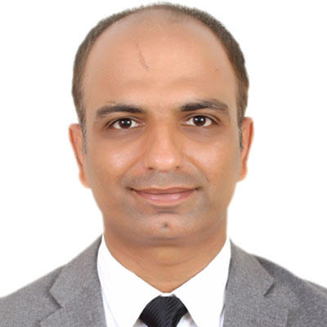
Dissertation (COM726) Module Leader
Dr Kashif Talpur
kashif.talpur@solent.ac.uk

Slide 4

Notes:
Introduction
All undergraduate and graduate students complete their studies by undertaking a large self-directed independent assessment, referred to as a Dissertation or Final Project. Traditionally completing a Final Dissertation Project would be the first chance an undergraduate student would have in publishing an academic paper. Through completing a Final Project, an undergraduate will transition from a student to a professional practitioner.
As part of Level 6 of your Bachelor’s Degree you are required to undertake a Final Major Project. The content of the project should reflect your interests, but must be drawn from relevant theory and be supported by the practical aspects of your degree.
The completed project must demonstrate your ability to plan, execute and present the findings of a suitable applied research topic. The final output will consist of a 10,000-word report, involve 400 hours of project time and the production of an artefact.

Slide 5
All Masters students undertake an extended body of work commonly called a Dissertation and an accompanying verbal presentation (Viva) The content of the Dissertation should reflect your passions and interests within your field of study, and must be drawn from relevant theory, supported by the practical aspects of your degree.

Slide 6
“Knowledge is of two kinds. We know a subject ourselves, or we know where we can find information about it.”
Samuel Johnson 1709-1784
SAMUEL JOHNSON cited in BOSWELL, J., 2008. The Life of Samuel Johnson (Penguin Classics). Cambridge UK
Notes:
You need to be an independent learning
The Project is a self-managed assessment which means students are responsible for the selection of a topic, driving their project and their own learning forward.
It is envisioned that you will bring together all the skills you have acquired so far from first and second year, and build on these working on your project.
Skills Needed: Researching, project management, time management, academic writing, critical thinking, problem solving, collecting and analysing data and ability to create your artefact.
It is important from the onset that you strengthen your academic skills in sourcing literature, structuring reports, academic writing, citation and referencing.

Slide 7
Week | Date | Topic
1 | 27/6/23 | Introduction to Support Assessments & Deadlines Report Writing and Referencing
2 | 4/7/23 | Research & Ethics
3 | 11/7/23 | Literature Review & Frameworks
4 | 18/7/23 | Project planning & Pilot Study
5 | 25/7/23 | Your Project What could your project look like? What’s your research question? What outcome would you like to achieve?
6 | 1/8/23 | Final Support Recap Academic writing and proofreading Milestones & Deadlines
There will be 6 support sessions taking place every Tuesday 1300-1400 in HC005 Lecture Theatre

Slide 8
Start Dissertation COM726 in September 2023 Submit Final Report in January 2024

Slide 9
Project Proposal Outline - NOT GRADED Monday 4th September 2023
Allocation of a supervisor by end of September 2023

Slide 10

Supervision
Notes:
Once the Project Outline has been accepted in Semester 1, it is then your responsibility to carry out the project within the agreed time to completion at the end of Semester 2.
After initial discussion with your supervisor in Semester 1, you should start to select sources of supporting literature (secondary research) and explore the options for an appropriate project method/s, specifications, project risks, design strategy, project management, testing, and how to best gain feedback on your project including how to analyse the results that have been gained.
It is important that you organise the information you collect by documenting it within a Logbook and storing it in a project Library.

Slide 11
Your supervisor will expect to see you following the submission of the Project Proposal Outline.
…and well offer 6 hours of support until final submission
Notes:
Your supervisor will expect to see you following the submission of the Project Outline in Semester 1, and then weekly, or more frequently as conditions demand throughout Semester 2. The onus is on the student to present evidence of their project progress at each supervision meeting.

Slide 12
REPORT 1 (20%) - 30/10/2023 Pilot Study/feasibility/progress
REPORT 2 (70%) - 8/01/2024 Final Report Presentation (10%) -15/01/2024 Viva & Q&A

Slide 13
What next?

Slide 14
What next?
Read academic papers & journals
Choose a project topic
Complete the project outline

Slide 15
Strengthen academic skills:
Defining a research problem
Research & project methods
Collecting & organising sources
Referencing (Harvard SU)

